Slide 1
Peace of Mind & Mental Health
Dr Charlie Easmon
Medical Director
Twitter @charlieeasmon

Slide 2
THE MIND – Close your eyes
A Pony or a Stallion ?
YOU as the Rider

Slide 3
WhAt is Abnormal?
Ronald J Comer defines ‘psychological abnormality’
DEVIANCE
DISTRESS
DYSFUNCTION
DANGER

Slide 4
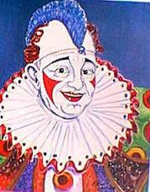
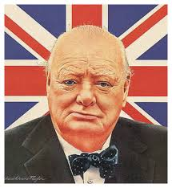
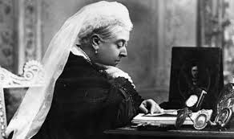
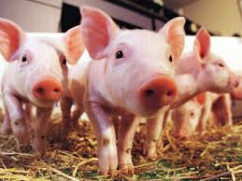
Anybody can be affected

Slide 5
The range of mental health
Stress reaction underlies everything
Clinical depression & Bi-polar illness (manic depression)
Raised anxiety states
Phobic disorders
Obsessive-Compulsive Disorder
Substance abuse (drug and alcohol)
Psychotic conditions in a non-acute phase (Schizophrenia ?%)
Personality Disorders (?%)
Eating Disorders

Slide 6
ANOREXIA
Anorexia is the leading cause of mental health-related deaths.
Most cases of anorexia develop in girls and women. One in every 200 women is affected. Symptoms of anorexia usually first develop during the teenage years, at the average age of 15. The condition can develop at any time, including childhood.

Slide 7
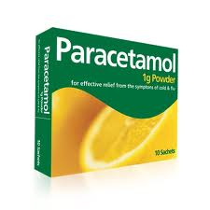
Suicide VS PARASUICIDE
The Cry for help

Slide 8
mental health Problems in those with Disabilities
According to AUTISTICA – 75% 1 mental health disorders & 40% at least two.(www.autistica.org.uk)
Substance abuse (drug and alcohol)
HOW WE TREAT EACH OTHER MATTERS

Slide 9
Nature, nurture & Narrative
What we are born with
How we develop
What we believe & what we are told

Slide 11
narrative
A teenager who was found dead in woods almost six weeks after his father shot his mother in a hair salon died from hanging, an inquest has heard.The body of Jack Williams 16, was found in Brynglas Woods, Newport. His father, Darren Williams, was also found dead in the same woods as police searched for him after he shot his estranged wife.

Slide 12
Mental health IN SOCIETAL CONTEXT
Prof Andrew Oswald of Warwick University blames 3 main factors1 of the 3 is
endlessly measuring self against peers which fuels 'a giant rat race’

Slide 13
Mental health problems common & COSTLY
1 in 6 in workplace (snapshot) have anxiety, depression or distress
Rises to 1 in 5 if drugs/alcohol included
Of these less than 25% seek/receive help for anxiety and depression
Less than 13% seek/receive help for drugs/alcohol

Slide 14
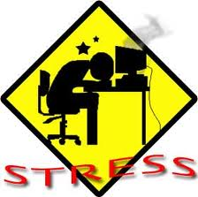
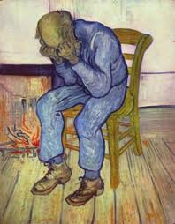
Stress, Anxiety or Depression or a mix?

Slide 15
What is stress?
Narrow – hardship – tension – wear and tear ?
Strung out?
Physiological effects?
Something caused by stressors and/or role conflicts?

Slide 16
Work Stress

Slide 17
The Yerkes–Dodson law
….is an empirical relationship between arousal and performance, originally developed by psychologists Robert M. Yerkes and John Dillingham Dodson in 1908. The law dictates that performance increases with physiological or mental arousal, but only up to a point.

Slide 18
FINANCIAL STRESS In THE UK
10% of employees believe financial concerns negatively affect their performance at work.

Slide 19
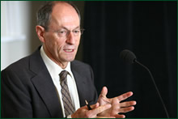
Lack of Control
Whitehall studies
http://www.marmotreview.org/

Slide 20
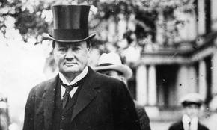
CoNTROL
Control is essential to the peace of mind not only of the head of a business but of the humblest employee Lord Northcliffe

Slide 21
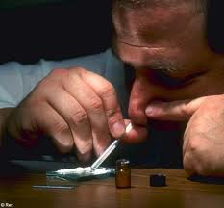
Spotting Stress/Mental Distress
Mood changes – ‘snappy’, easy tears

Slide 22
Reducing Stress & Improving Mental Health
Sleep & Control
Exercise
Healthy Eating
Reduce Exposure to Social Media
Identify problems early
Seek help

Slide 23
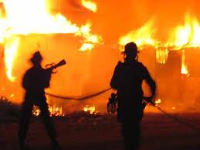
Stress is a 999 Call!

Slide 24
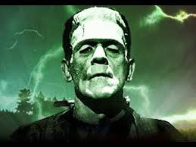
DEPRESSION

Slide 25
Depression
Flat mood
Lethargy
Loss of appetites
Sleep disturbance
Negative thoughts
Recurring thoughts
Endogenous vs Reactive
Bipolar

Slide 26
Are you empathetic?

Slide 27
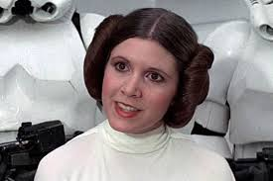
What can be done to help
Nothing
Talking Therapy/Friends
(www.moodmapping.com &
www.headspace.com)
Medication
RTMS – Repetitive Transcranial
Magnetic Stimulation
Electro-Convulsive Therapy (ECT)

Slide 28
Treatment options Rx
CBT Cognitive behavioural therapy
DBT Dialectical behavioural therapy based in Buddhist mindfulness
MBT Mentalisation based treatment concentrates on better understanding of your own and others mental states.

Slide 29
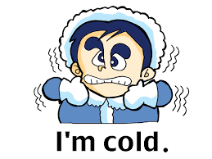
Personality Disorders 10 in 3 groups
Odd behaviour 3
Paranoid
Schizoid
Schizotypal

Slide 30
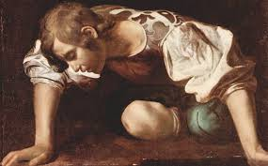
Personality Disorders 10 in 3 groups
Dramatic 4
Antisocial
Borderline
Histrionic
Narcissistic

Slide 31
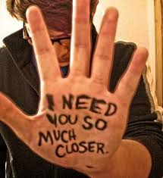
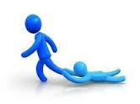
Personality Disorders 10 in 3 groups
Anxious 3
Avoidant/Social Anxiety Disorder
Dependent
Obsessive-compulsive

Slide 32
Sexual Identity – more complex than we realise

Slide 33
The tears of the clowns

Slide 34
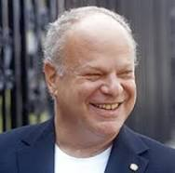
Positive psychology & the Science of Happiness

Slide 35
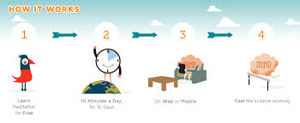
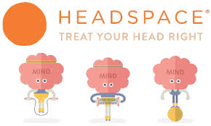
HEADSPACE

Slide 36
The Famous
Clinical depression (Churchill/Trescothick/Geldof)
Personality Disorders/Raised anxiety states (Performers Too Numerous To Mention)
Bi-polar illness (manic depression) (? ChurchillStephen Fry/Catherine Zeta-Jones)
Substance abuse (drug and alcohol) (Performers TNTM)
Psychotic conditions in a non-acute phase

Slide 37
Thank you
Time for discussion

